Slide 1
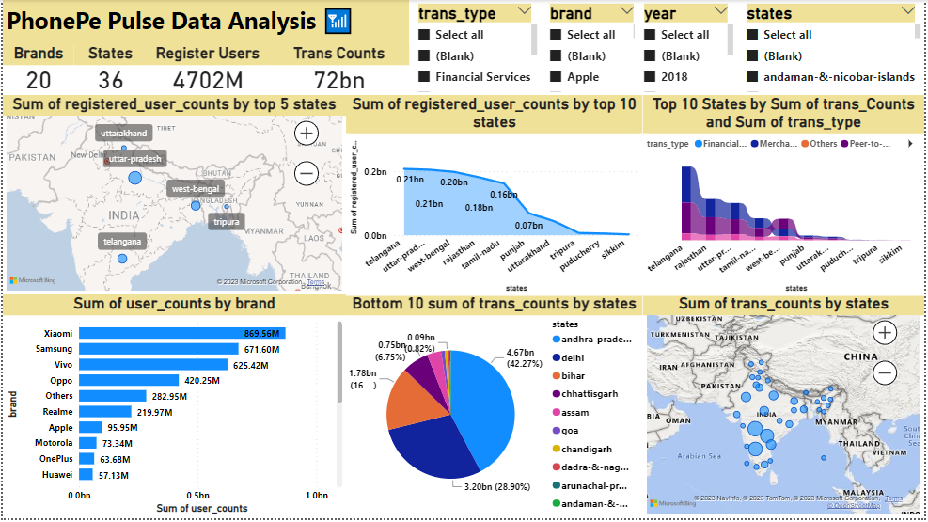
PhonePe Pulse Data Analysis📶
Summary:
Designed Interactive dashboard with a given data using PowerBI visualisation tool and also used some Main Components of Geo-Visualisation, Transactions Analysis, Users Analysis & Top states data are performed.

Slide 2
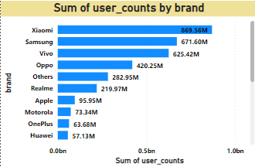
Insight 1:
As per the analysis of the given data Xiaomi is the top of the Brand with the 869.56 M users of PhonePe & followed by the other brands.

Slide 3
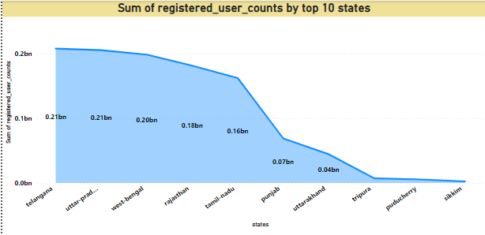
Insight 2:
As per the analysis of states, Telangana is the top first State having 0.21 bn registered users of PhonePe. Compared to 36 States below are the top 10 states where the registered user counts are high in numbers.

Slide 4
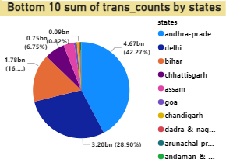
Insight 3:
As per the year Analysis Andhra Pradesh has the Most Year transaction Counts when compared to all other states. Even though Andaman Nicobar has less number of people they falls under top 10 of transaction counts.

Slide 5
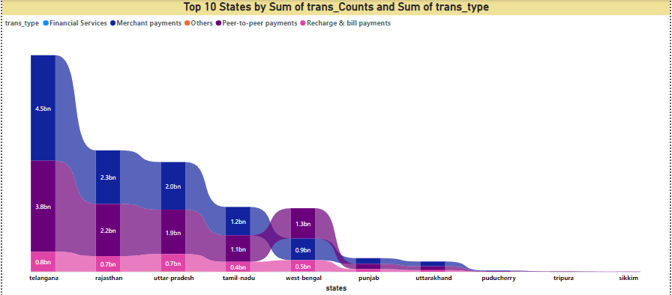
Insight 4:
As per the analysis Merchant payments has the top most used transaction type when compared to other transaction type. Recharge & bill payments are the least transaction type used by the user.

Slide 6
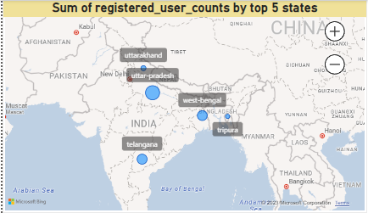
Insight 5:
As per the analysis the Uttar Pradesh, Telangana, West-bengal, Uttarakhand & Tripura are the top 5 states where the registered user counts are high in number.

Slide 7

KPI:
As per the data we have 36 states with brand wise users of 20 and the PhonePe registered users are 4702M with 72BN transaction counts.
Conclusion:
Overall data explains that the PhonePe users increasing year by year and there is no downfall of users. Xiaomi users are the top users of PhonePe for the all four years from (2018-2022).

